Slide 1
Preface
1. Big Data Fundamentals: Covers Apache Spark and Hadoop, integrating commonly used tools and techniques.
2. Spark Components:
- Core, SQL, DataFrames, Datasets, Conventional & Structured Streaming.
- Machine Learning (MLLib), Graph Analytics (GraphX).
3. Hadoop Core: Includes HDFS, MapReduce, and Yarn.
4. Spark vs. MapReduce: Highlights the advantages of Spark over MapReduce, especially for in-memory speeds.
5. DataFrames API & Dataset API: Key tools for building big data applications.
6. Real-time Data: Using Spark Streaming, Kafka, HBase, and IOT examples.
7. Machine Learning & Graph Analytics: Using MLLib, ML Pipelines, SparkR, GraphX, and GraphFrames.
8. Web Notebooks: Jupyter, Apache Zeppelin for analysis and visualization.
9. Data Flow Tool: Apache NiFi, Livy Server offers Spark as a service.

Slide 2
Introduction
What is Big Data?
Big Data refers to vast sets of data generated in multi-terabyte quantities that are too complex to be processed or analyzed using traditional relational database management systems (RDBMS) or other conventional technologies. The primary goal of big data is to uncover patterns, trends, and insights that can help businesses and researchers make informed decisions.
What is Big Data Analytics?
Big Data Analytics is the complex process of examining large and varied data sets (Big Data) to uncover valuable information, such as:
Hidden Patterns
Unknown Correlations
Market Trends
Customer Preferences
This process helps organizations make informed business decisions.

Slide 3
Difference Between Data Analytics and Data Science
Big Data Analytics: The process of analyzing large data sets to provide past, current, and future insights that assist in better business decision-making.
Two Main Categories:
1. Data Analytics:
- Focuses on the collection and interpretation of data.
- Emphasizes past and present statistics.
- Includes:
- Descriptive Analytics: What happened?
- Diagnostic Analytics: Why did it happen?
2. Data Science:
- Focuses on explorative analytics for future predictions.
- Uses models based on past and present data to make recommendations.
- Includes:
- Predictive Analytics: What will happen?
- Prescriptive Analytics: What should be done?
Key Points:
- Data analytics deals with interpreting historical data.
- Data science helps predict future trends and provide recommendations.

Slide 4
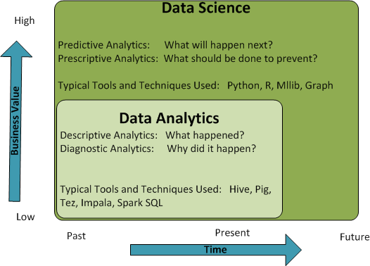
difference between data analytics and data science for time and value achieved
Figure 1.1: Data analytics versus data science

Slide 5
The following table explains the differences with respect to
processes, tools, techniques, skill sets, and outputs:
 | Data analytics | Data science
Perspective | Looking backward | Looking forward
Nature of work | Report and optimize | Explore, discover, investigate, and visualize
Output | Reports and dashboards | Data product
Perspective | Looking backward | Looking forward
Nature of work | Report and optimize | Explore, discover, investigate, and visualize
Output | Reports and dashboards | Data product

Slide 6
Big Data Analytics and Role of Hadoop & Spark
Traditional Data Analytics:
- RDBMS databases are used to create data warehouses.
- Follows a Schema-on-Write approach, where data must be structured before analysis.
- Involves the ETL process:
1. Decide predefined questions.
2. Collect data from sources.
3. Build ETL pipelines to format the data for analytics.
- Limited flexibility: Adding new questions requires reworking ETL pipelines, often taking months.
- Loss of raw data: Data is transformed, losing potential insights from raw, unstructured data.
- Struggles with processing large, unstructured data (e.g., images, videos).
Big Data Analytics:
- Uses Hadoop with Schema-on-Read via tools like Hive and HBase.
- Keeps raw data intact, allowing for more flexible and detailed analysis.
- Can handle structured and unstructured data efficiently, overcoming traditional system challenges.

Slide 7
Schema-on-Read Approach: Flexibility and Reusability
Key Concept: Store data in raw, unmodified format and apply the schema only when the data is read or processed.
Benefits:
  Flexibility: Multiple schemas can be applied to the same raw data, enabling different types of questions to be answered.
  Adaptability: If new questions arise, simply add new data and store it in HDFS, without restructuring existing data.
  Reduced Costs: Avoids multiple data transformations and layers, lowering storage and data movement costs.
  Versatile Analysis: The same raw data can be analyzed using SQL, Python, or R scripts in tools like Spark, handling both structured and unstructured data sources.

Slide 8
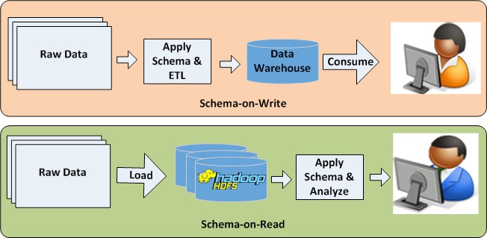
Example:
Figure 1.2: Schema-on-Write versus Schema-on-Read

Slide 9
Typical Big Data Analytics Project Life Cycle
Identifying the Problem and Outcomes:
  Clearly define the business problem and the desired outcome (e.g., reducing cart abandonment or increasing sales).
  This helps determine the data needed and the analytics to be performed.
Identifying the Necessary Data:
  Identify the quality, quantity, format, and sources of data.
  Data can come from internal sources (e.g., OLAP, OLTP databases) or external sources (e.g., internet, sensor data).
  Consider data anonymization to protect personally identifiable information (PII).
Data Collection:
  Use tools like Sqoop to pull data from relational databases and Flume to stream data.
  Implement fault-tolerant data collection using systems like Apache Kafka.
Preprocessing Data and ETL:
  Convert and clean data to a required format using tools like Apache Hive, Pig, or Spark SQL.
  This step may be skipped if using the Schema-on-Read approach.
Performing Analytics:
  Use descriptive, diagnostic, or predictive analytics to answer business questions.
  Tools like Hive, Pig, Spark, and HBase can be used for batch processing or real-time analytics.
  Real-time analytics can integrate with business intelligence tools (e.g., Tableau, QlikView).
Visualizing Data:
  Present the output in a pictorial or graphical format to support decision-making.
  Data can be exported to RDBMS using Sqoop or directly visualized with tools like Tableau, QlikView, Jupyter, or Zeppelin.

Slide 10
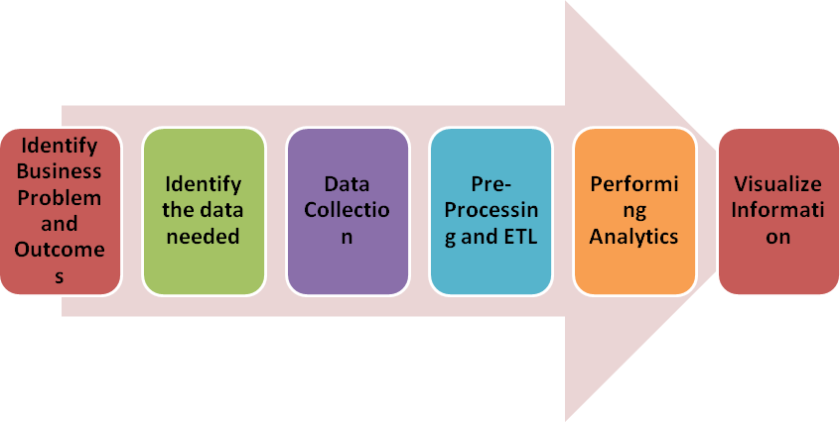
Figure 1.3: The Big Data analytics life cycle

Slide 11
Role of Hadoop and Spark in Data Science
Apache Hadoop provides distributed storage and resource management, making it suitable for handling large data sets across clusters of computers. Apache Spark, on the other hand, delivers in-memory processing for faster data science applications.
Advantages for Data Science Projects:
Wide range of applications and support for third-party packages.
Includes a machine learning library for easier implementation of algorithms.
Integrations with deep learning libraries such as H2O and TensorFlow.
Interactive analytics support through languages like Scala, Python, and R.
Unified capabilities for SQL queries, machine learning, and data streaming.

